Slide 1

Data Analysis
Student Alcohol Consumption
Piotr Wojciechowski – X00152561

Slide 2
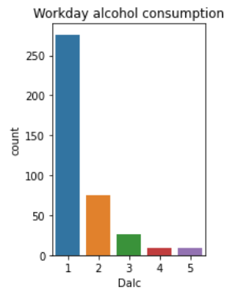
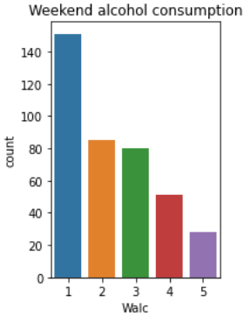
How much alcohol is consumed by secondary school students
No student said that they don’t consume any alcohol during the week
On average students consume a little alcohol (1) on workdays
During the weekend the average goes up to 2
Students tend to be more responsible when they know they have school

Slide 3
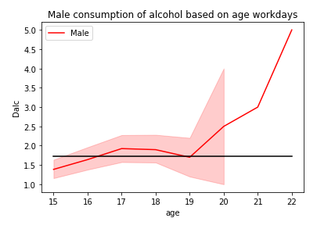
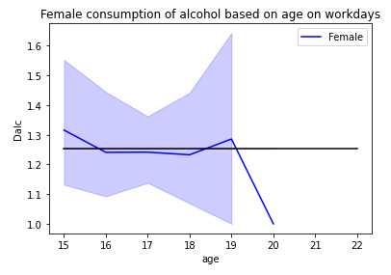
Alcohol consumption levels based on age - workdays
During the workdays both sexes from ages 15-17 consume a small amount of alcohol.
After the legal drinking age, the amount spikes up probably because they can legally buy alcohol.
Some males fail their classes and must continue studying, this seems to lead to a lot of alcohol usage.
While some of the females also had to continue their studies, they consumed a lot less alcohol compared to males.

Slide 4
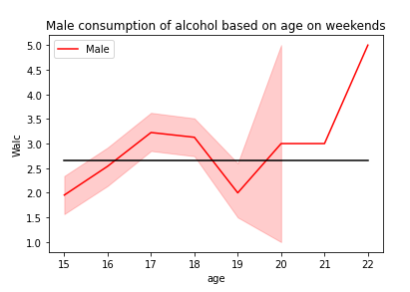
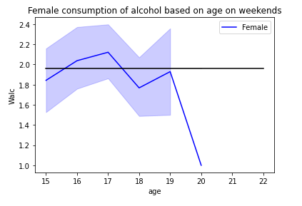
Alcohol consumption levels based on age - weekends
In both groups students are drinking more alcohol on the weekends even at younger ages.
Male students have a higher average when drinking alcohol.
Student’s under legal age consume more alcohol than those over the legal drinking age

Slide 5
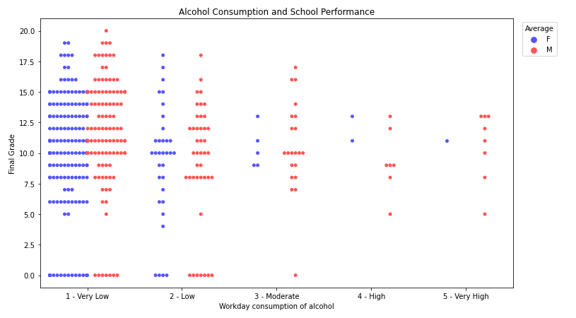
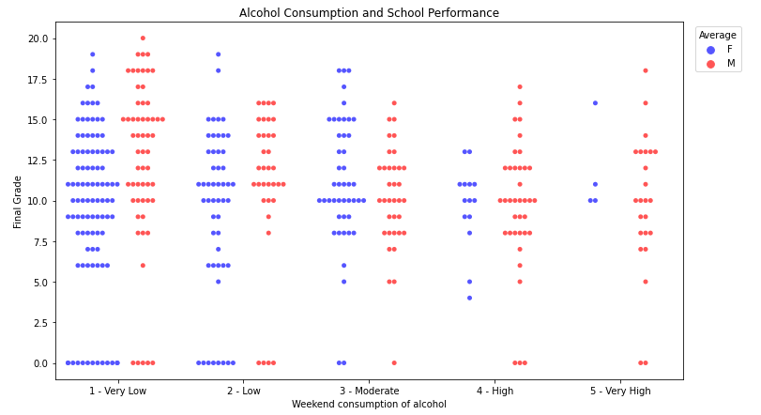
Does alcohol consumption affect your grades in school - overview
Data is congregated on a very low level of alcohol usage in the top left graph.
Majority of students tend to score above average.
Students who consume more alcohol on workdays have score’s slightly lower than others.
Highest grade achieved was 20
Students who drink less achieve better results

Slide 6
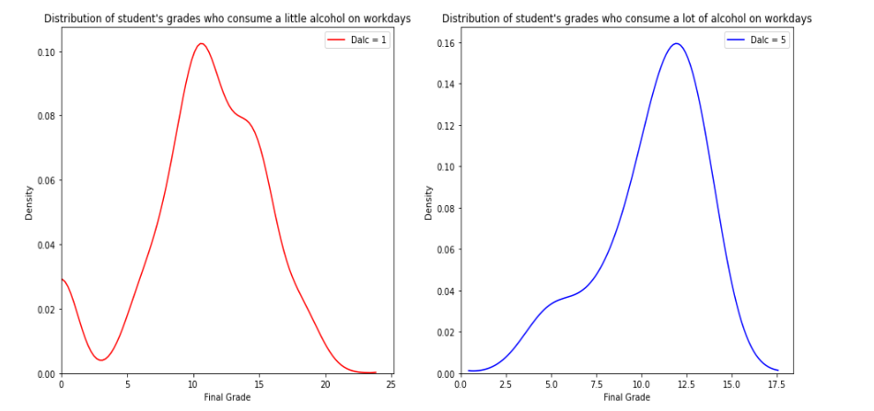
Which group of students are inclined to score more in their final grade
Does who love to drink score much less compared to the number of those who spend their weekdays sober
Final grade ends up significantly lower (17.5) for those who drink a lot.
The Pearson correlation is -0.05
The p-value for it is 0.29

Slide 7
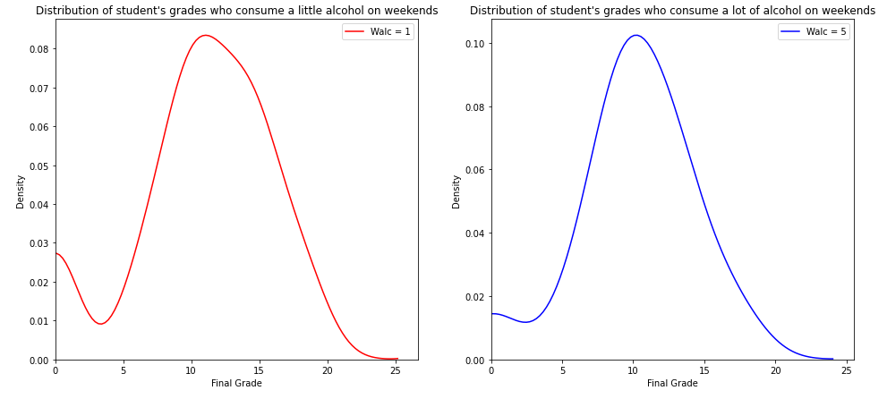
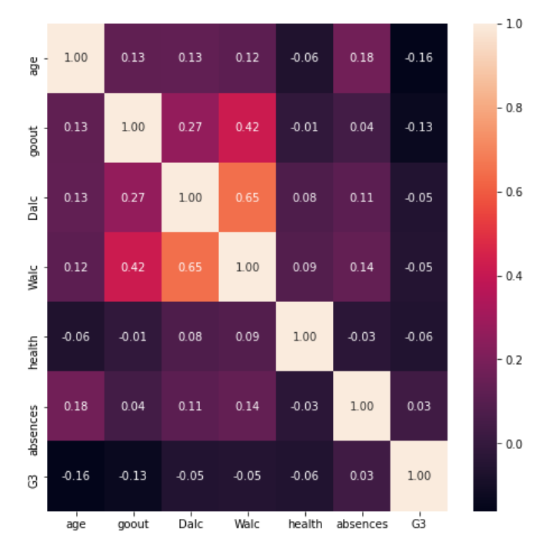
Which group of students are inclined to score more in their final grade
Weekend alcohol consumption has no big effect on the grade.
The Pearson correlation is -0.05
The p-value for it is 0.3

Slide 8
Conclusion
Student’s tend to be more responsible and do not consume too much alcohol on workdays.
There is no significant impact on student’s final grade when they consume a lot of alcohol during the weekend
Those who consume a lot during workdays do see a massive drop in score.
Overall, though the p-value we achieve is higher than 0.05 meaning higher alcohol consumption does not affect student grades
We failed to reject the hypothesis but have gained a lot of insight into student alcohol usage.
Thank you for listening to my presentation

